Slide 1
Housing Price Prediction

Slide 2
Content:
Introduction
Problem Statement
Insights of the project
Analytical Problem
EDA
Visualizations
Data Pre Processing and Feature Engineering
Model Development and Evaluation
Conclusion

Slide 3
Introduction:
Houses are one of the necessary needs of each and every person around the globe and therefore housing and real estate market is one of the markets which is one of the major contributors in the world’s economy. It is a very large market and there are various companies working in the domain. Data science comes as a very important tool to solve problems in the domain to help the companies increase their overall revenue, profits, improving their marketing strategies and focusing on changing trends in house sales and purchases. Predictive modelling, Market mix modelling, recommendation systems are some of the machine learning techniques used for achieving the business goals for housing companies. Our problem is related to one such housing company.

Slide 4
Problem Statement:
A US-based housing company named Surprise Housing has decided to enter the Australian market. The company uses data analytics to purchase houses at a price below their actual values and flip them at a higher price. For the same purpose, the company has collected a data set from the sale of houses in Australia. The data is provided in the CSV file below. The company is looking at prospective properties to buy houses to enter the market. You are required to build a model using Machine Learning in order to predict the actual value of the prospective properties and decide whether to invest in them or not. For this company wants to know:
1. Which variables are important to predict the price of variable?
2. How do these variables describe the price of the house?

Slide 5
Insights of Project:
How the location of the lot decides the selling price of the property.
How the amenities like Garages, Swimming pool, parking lot, fence type, insulation type and quality increase the selling prices.
How the number of rooms directly increases the cost and size of the property.
What is the type of building and the year built mostly comes for the sales?
The year the building build versus the cost of the property.
The year the modified versus the cost of the property.
Nearby neighborhood versus cost of the property.

Slide 6
Analytical Problem:
Analytic problem framing involves translating the business problem into terms that can be addressed analytically via data and modeling. Analytic problem framing is the antithesis of merely working with the ready-to-hand data and seeing what comes of it, hoping for something insightful.

Slide 7
Exploratory data analysis
House price prediction problem consist of 2 datasets Training and Testing dataset. Trained dataset to train the model and Testing to predict the model output.
First, the analysis is started with importing the data, this dataset contains lot off Null values which are cleaned by using mean(), median(), mode() functions and unnecessary columns which does not contribute for the target variable is removed.
Once data is cleaned outliers and skewness are checked, if present they are removed then in Data Pre-processing, Standard Scaler is used to standardize the data and by using VIF, multicollinearity is removed.

Slide 8
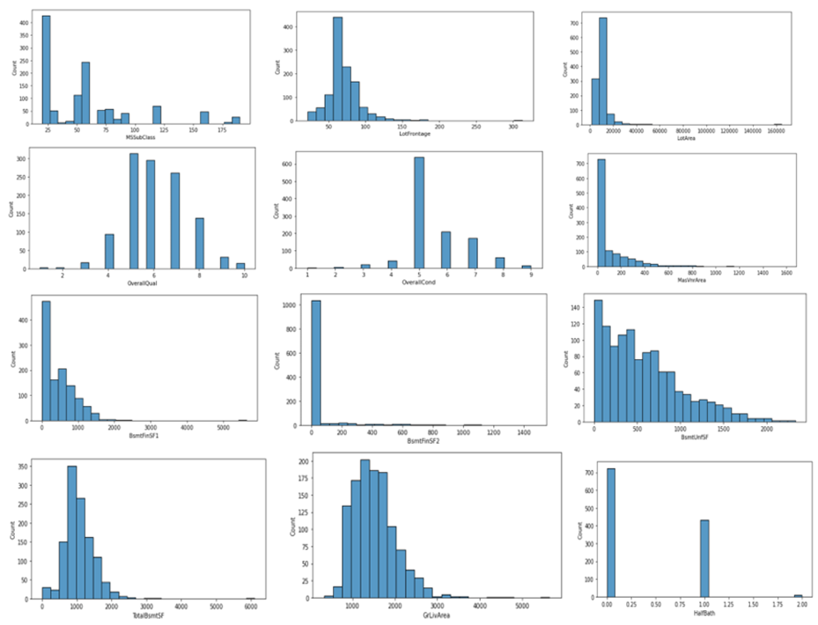
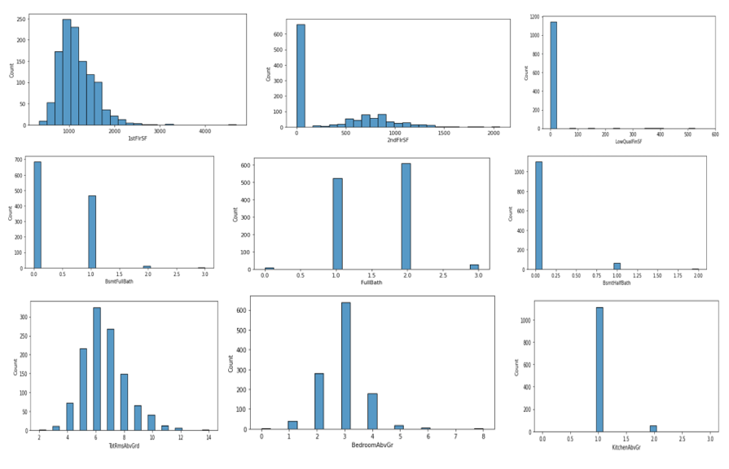
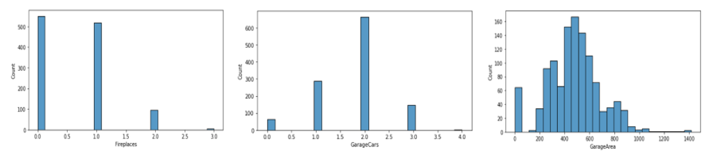
Visualization:

Slide 9
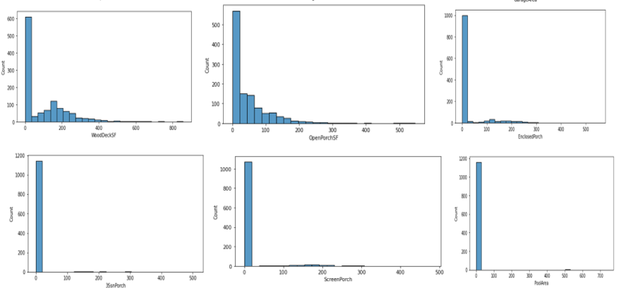
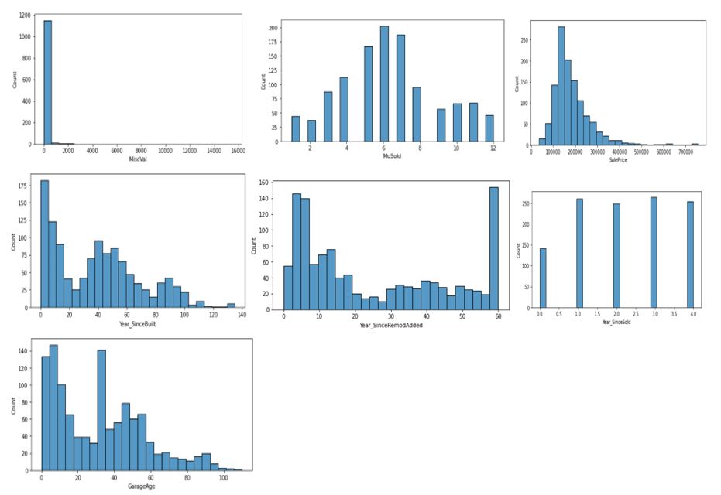
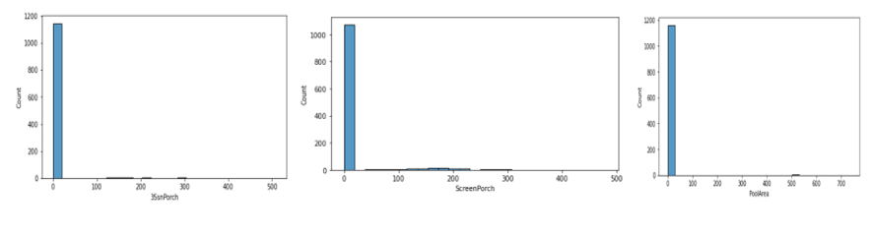
Cont.

Slide 10
Key Observations:
As MSSubClass is increasing, sales is decreasing. And it is seen between 25-75 there are a greater number of sales.
As LotFrontage increases, sales decreases. And more sales is between 25 and 100
As LotArea increases, sales decreases.
OverallQual is more between 4 and 8.
OverallCond is more at 5 and then sales decreases. Sales deponds on condition of the building if it is good sales increases otherwise it decreases.
AS MasVnrArea increases, sales decreases.
AS BsmtFinSF1 increases, sales decreases.
As BsmtFinSF2 increases, sales decreases.
As BsmtUnfSF increases, sales decrease gradually.

Slide 11
Cont.
As TotalBsmtSF increases, sales decreases.
As 1stFlrSF increases, sales decreases.
Sales is more at 2ndFlrSF at 0-50. Then it gradually decreases.
GrLivArea increases, sales decreases.
HalfBath,Kitchen may prefers 1 room. As size increases sales decreases.
GarageCar mostly prefered onr is 2 car parking.
Mostly prefered GarageAre is between 400 and 800. As area increases sales decreases.
As OpenPorchSf increases, sales decreases.
Many Prefer ClosedPorch.
As age of building increases, sales decreases. Most of them prefer newly constructed building
Sales price ranges from 1.5-2lakhs in most cases. And there are even people who prefers upto 7 lakhs but number of counts who prefer is less.

Slide 12
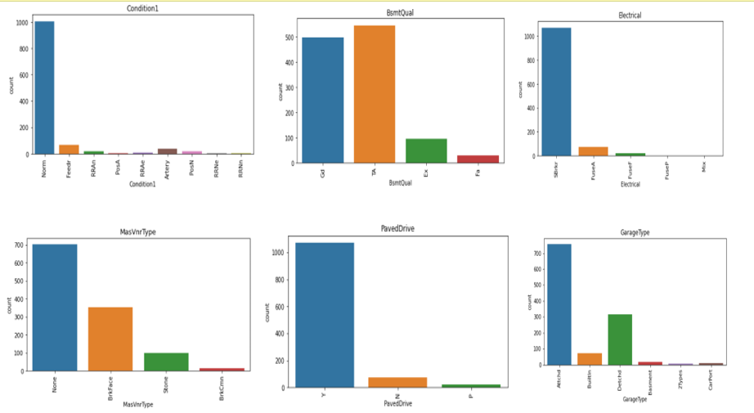
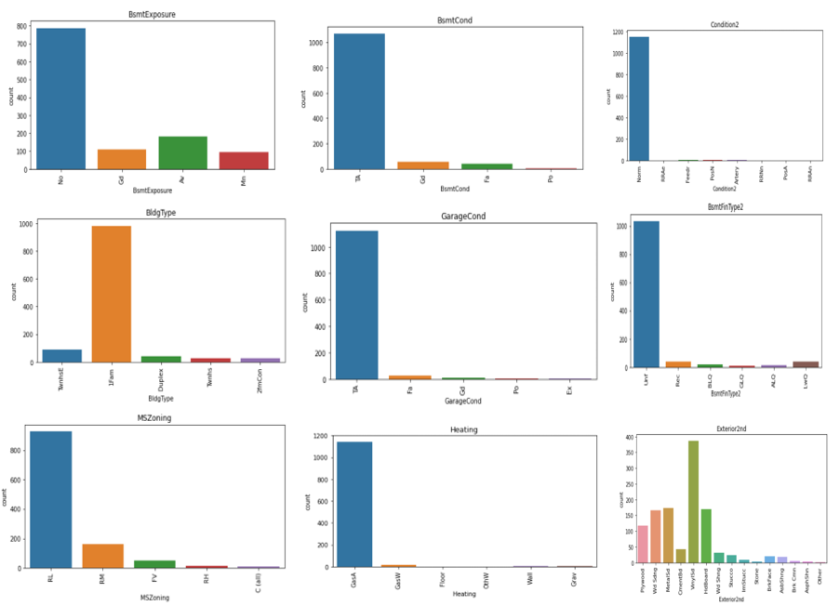
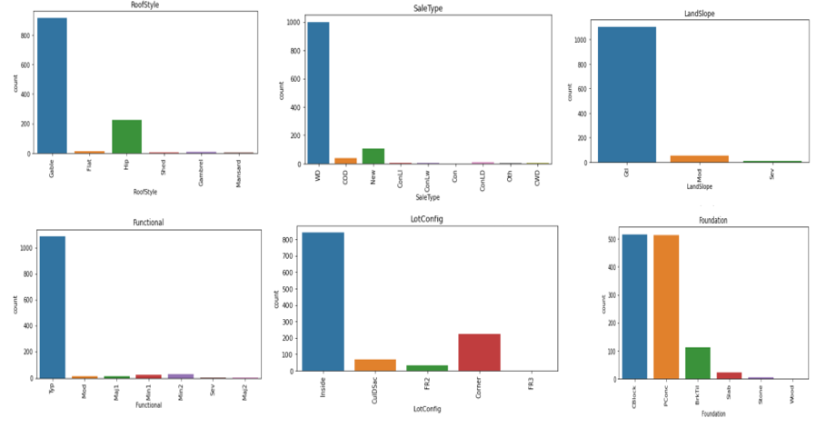
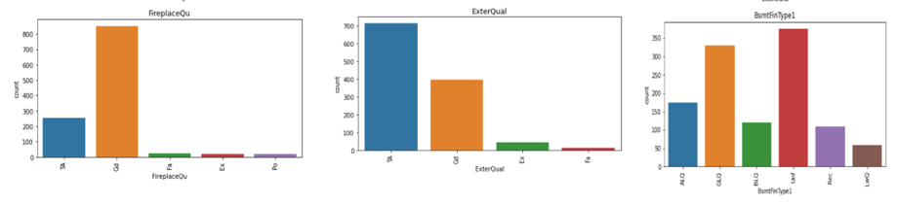
Visualization of Categorical data:

Slide 13
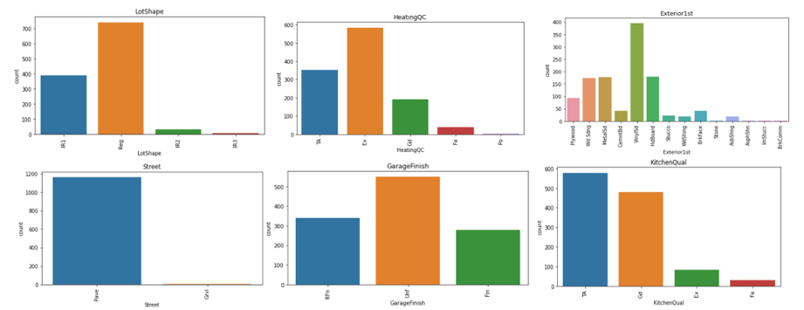
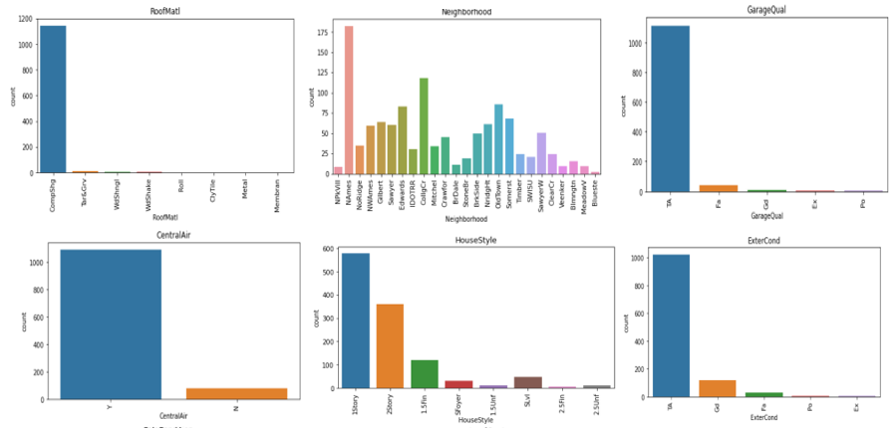
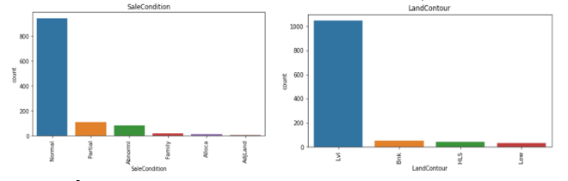
Cont.

Slide 14
Key Observations:
Evaluates the quality of material on the exterior TA(average/Typical) has more sales followed by gd(Good)
Proximity to various conditions(if more than one is present) Norm(Normal) sales is more.
Many prefered Vinyl Sliding(VinylSd) followed by Hard Board(HDBoard),Metal Sliding(MetalSd), WoodSliding(Wd Sliding)
Garage Location - Attached to Home(Attchd) sees high sales followed by Detached from home(Detchd).
BsmtExposure(Walkout or Garden level walls) many sales is done with No Basement followed by Av(Average Exposure).
Functional: Many sales is done for Typical Funcionality(Typ).
More sales is done in North Ames(NAmes) followed by College Creek(CollgCr) which sees high sales. and lowest sales is seen in Bluestem(Bluestem).
In Rating of basement finished area(BsmtFinType2) many sales done with Unf(Unfinished), followed by LwQ(Low Quality)
Many sales done foe TA(Typical/Average) Garage Condition.

Slide 15
Cont.
Many sales is seen with Unf(Unfinished) GarageFinish.
Sales Type is high in WD(Warranty Deed) followed by New(Home just constructed and sold).
LotShape(General Shape of Propert)- Reg(Regular) has seen more sales.
LandSlope(Slope of Property) -Gtl(Gentle Slope) has seen high sales.
Many sales are done with CentralAir conditioning.
Lvl(Near Flat/Level) has seen more slaes in LandContour(Flatness of Property)
MasVnrType(Masonry veneer type)- None has seen more slaes followed by BrkFace(Brick Face).
Foundation(Type of foundation) - CBlock(Cinder Block) has more sales followed by PConc(Poured Contrete)
BldgType(Type of Dwelling)- 1Fam(Single Family detached) has more sales, followed by TwnhsE(Townhouse End Unit)
MSZoning(General zoning classification)- more sales is done with RL(Residential Low Density) followed by RM(Residential Medium Density).
Electrical(Electrical System)- Many slaes is done for SBkr(Standard Circuit Breakers & Romex).

Slide 16
Cont.
SaleCondition - Mostly Normal Sale is done followed by Partial.
Mostly 1Storey has ssen high sales followed by 2Storey in HouseStyle.
GasA(Gas forces warm air furnace) with excellent quality is prefered in Heating Type which has seen large number of slaes.
RoofStyle and Material most sales happed with CompShg(Standard(composite) shingle) with Gable material.
Most saled happed with PavedDrive
LotConfig(Lot Configuration) Inside lot has seen more sales.
Lot of sales is seen in Good Fireplace Quality.
More sales is seen with Pave Street than Gravel street.
Kitchen, ExternalQual, GarageQual sales is seen high in TA(Average).

Slide 17
Data Pre-Processing and Feature Engineering:
In Machine Learning, data pre-processing refers to the process of cleaning and organising raw data in order to make it appropriate for creating and training Machine Learning models.
In other words, anytime data is received from various sources, it is collected in raw format, which makes analysis impossible. Data pre-processing is a crucial stage in Machine Learning since the quality of data and the relevant information that can be gleaned from it has a direct impact on our model's capacity to learn; consequently, we must pre-process our data before feeding it into our model.
As a result, it is the first and most important stage in developing a machine learning model.Some of the techniques used in this project are listed below:
Started with importing the required libraries and then the train dataset which is in csv format.
As the dataset contains 81 variables to display all the columns so in this pd.options.display.max_columns method is used by which all the columns can be observed. Then the information of the columns are observed carefully.

Slide 18
Cont.
The unique values is then found by which one can check if any unnecessary values like ? , / is present in the dataset and if present it can be dropped or replaced based on the use it has.
Few columns like ‘Id’, ‘Utilities’ is dropped as it has all unique values in it and does not contribute much in model building.
Then Null values is checked, where the dataset contains large number of null values. In this values which have more that 90% of zeros(0) is dropped as we cannot replace it with mean(), mode() values. Values in some columns are replaced with mean() and mode() as they are of numeric and categorical type.
Numeric data and Categorical data is then separated so that visualization are done with histplot for numeric data and countplot for categorical data.
Then all the categorical data is converted to numeric by using LabelEncoder so that analysis can be made in better way.
Data Description is made followed by correlation where positive and negative correlated data is checked.

Slide 19
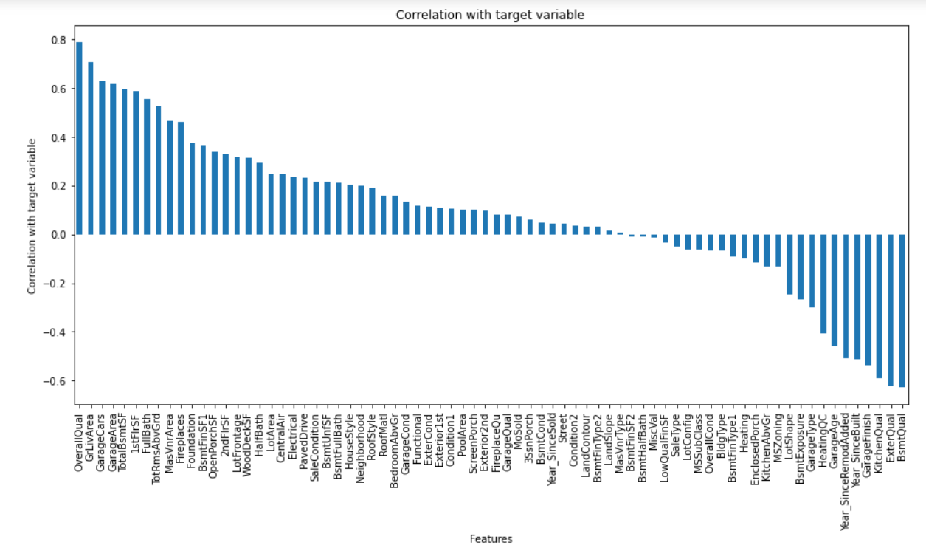
Correlation:
corr() is used to find the pairwise correlation of all columns in the dataframe.
In this project correlation is done with target variable ‘SalePrice’, by which we can observe that OverallQual, GrLivArea is highly positively correlated with target column, whereas BsmtQual, ExterQual is highly negatively correlated with target column.

Slide 20
Outliers:
An outlier is an observation that lies an abnormal distance from other values in a random sample from a population.
In this project mostly all columns contains outliers which is visualized in next slide.
These Outliers are removed by Z-Score.

Slide 21
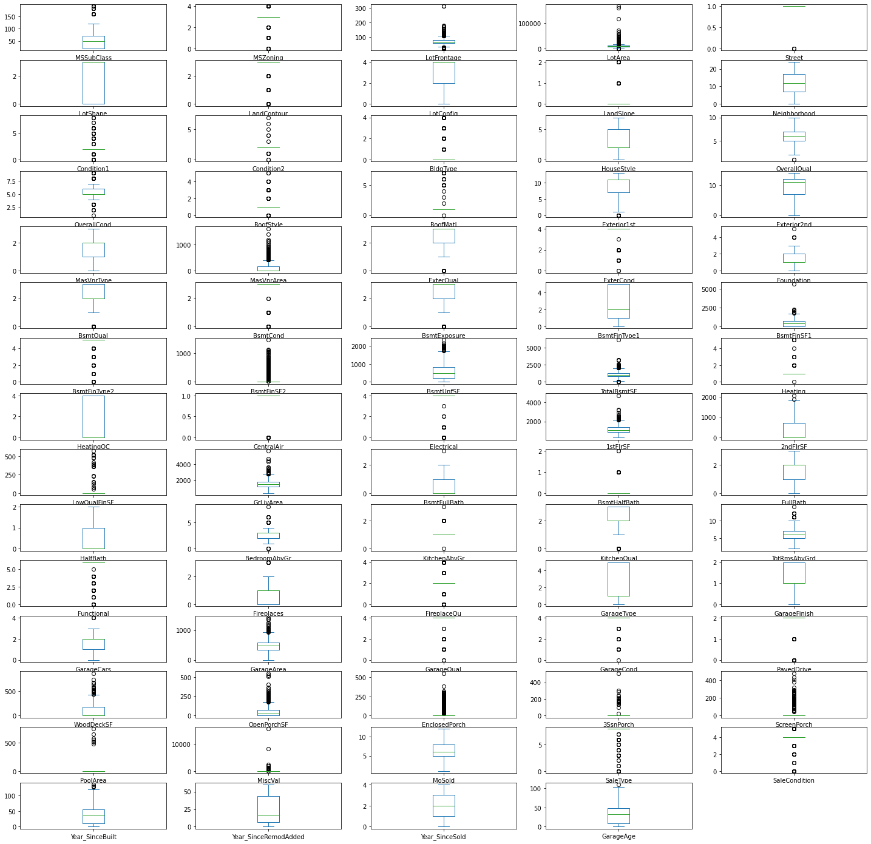

Slide 22
Skewness:
Skewness refers to a distortion or asymmetry that deviates from the symmetrical bell curve, or normal distribution, in a set of data.
Keeping skew values +/- 0.5 we can find that most columns have more value of skew.
Here in this project, power transform method is used to remove skewness and to get high accuracy of the model.

Slide 23
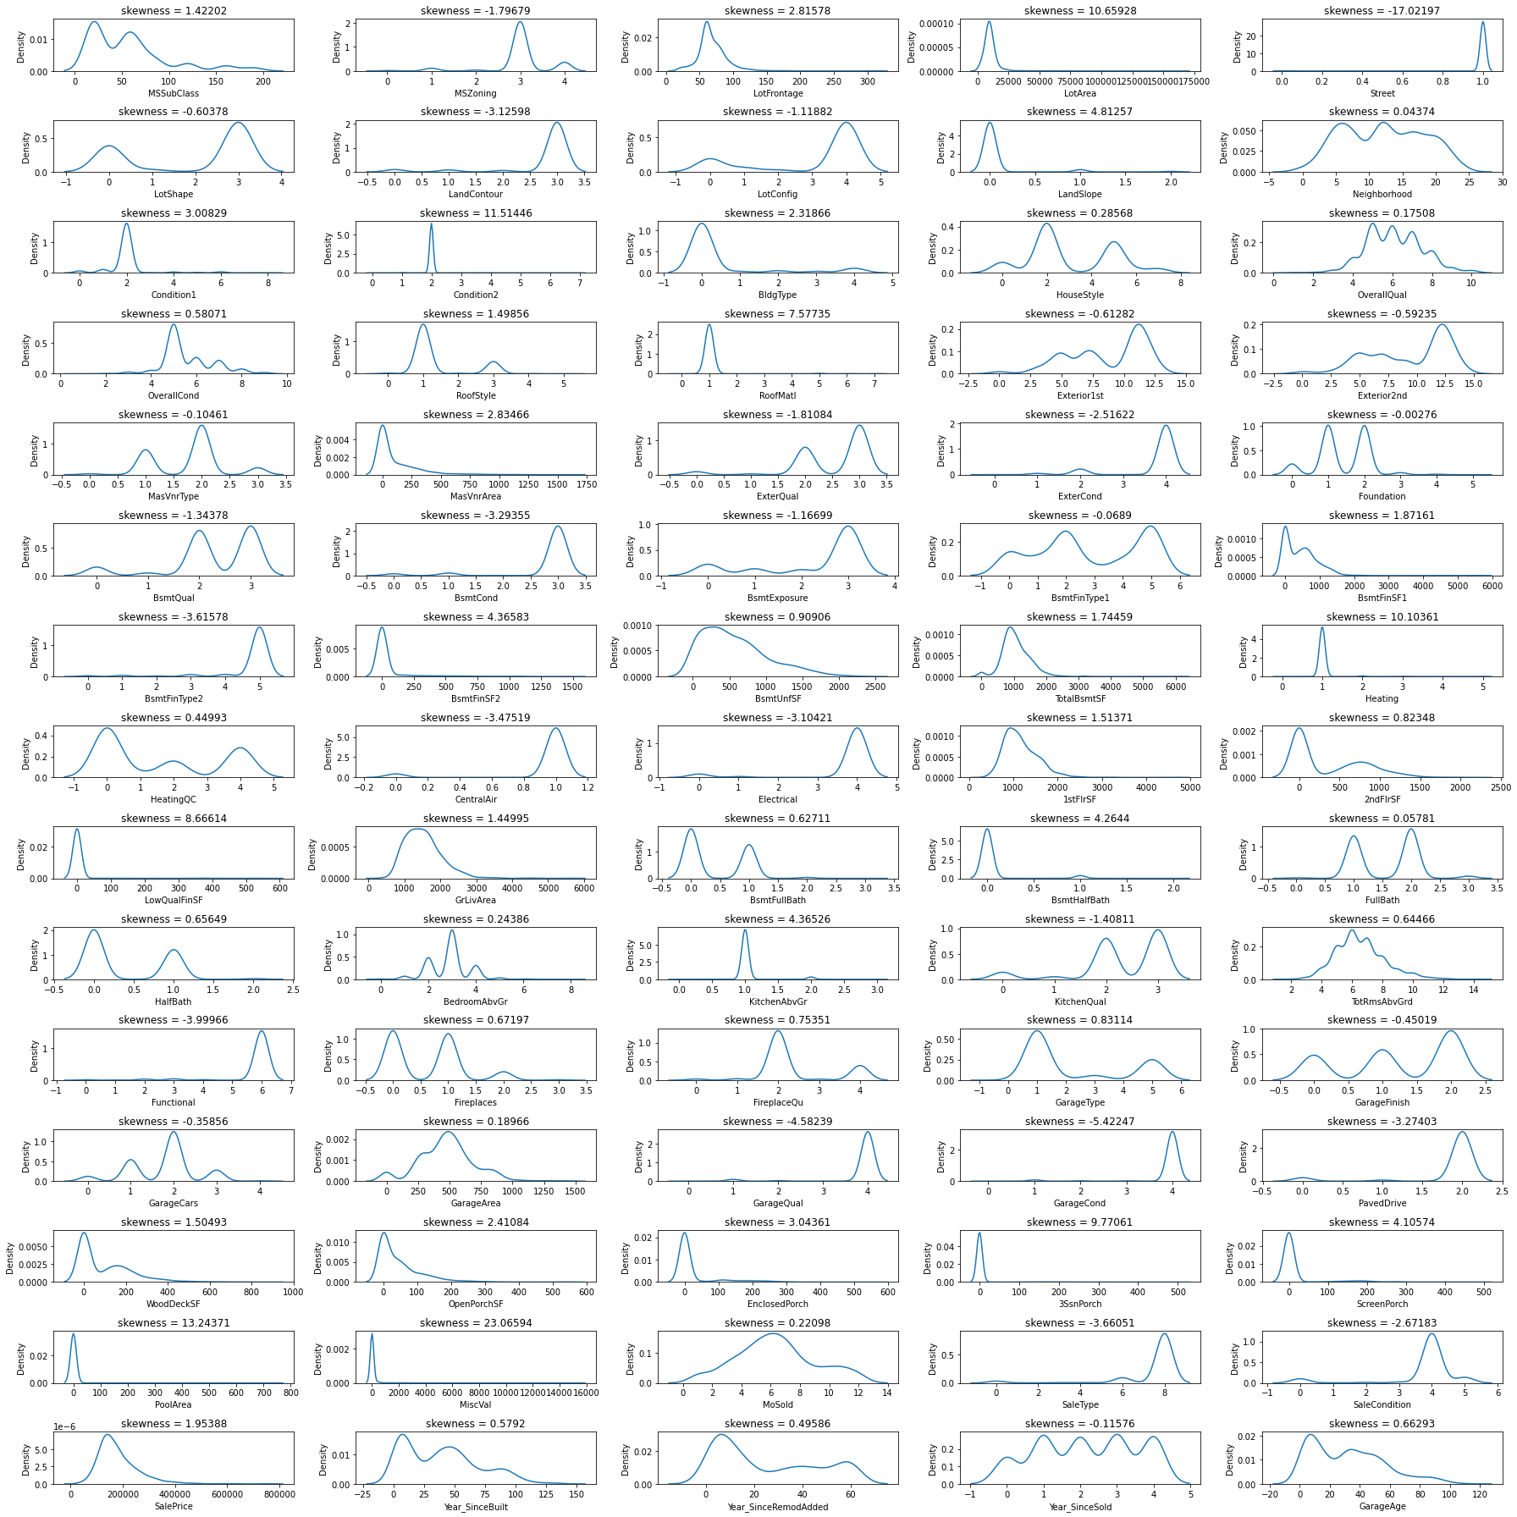

Slide 24
Cont.
Outliers and Skewness is checked and removed in order to avoid bias while model building.
Standard Scaler is used for data standardization and VIF is used to check Multicolinearity is checked to find if any data variable is correlated with each other and it is removed.
Once all these processes are done then data is ready for model building where various Machine Learning models is used to check the accuracy of data.

Slide 25
Model Development and Evaluation
The approaches followed in this project are
Find the best random state of a model.
Use all the other models to find accuracy score, mean squared error, mean absolute error and r2 score.
Then find Cross Validation of all models to find the best accuracy, which is the least difference between r2 score and cv score.
With the best model accuracy, we need to do hyper tuning using GridSearchCV.
Then finally saving the best model and by keeping this we need to predict the SalePrice of test dataset.

Slide 26
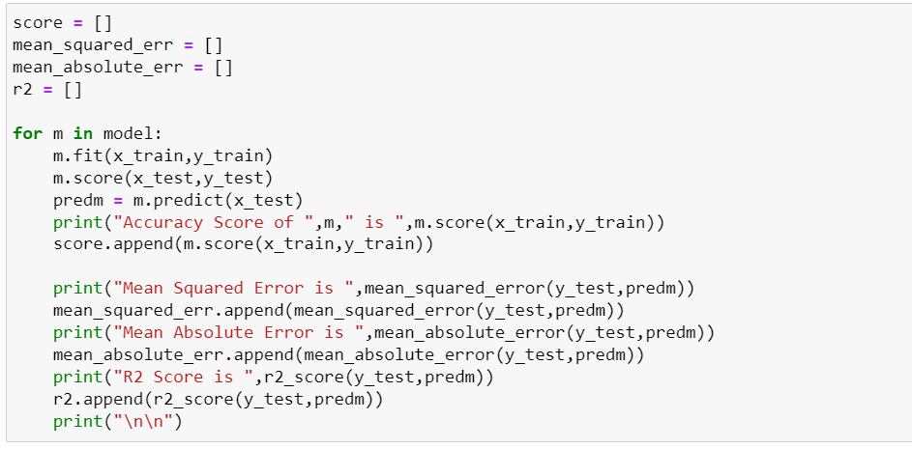
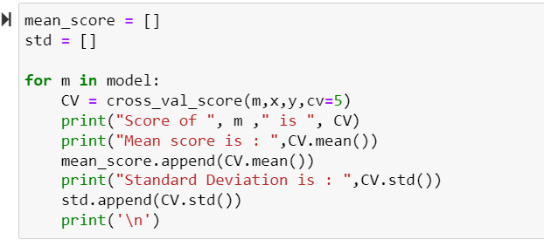
Here accuracy score,r2_score, mse , cv is checked for all models and final model is selected.

Slide 27
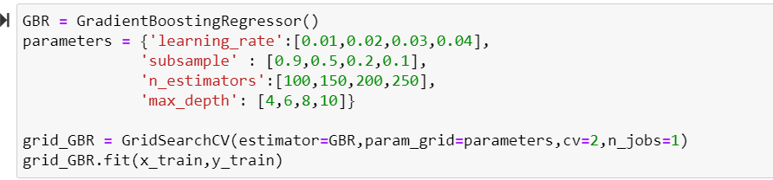
Hypertuning is done to improve model accuracy for GradientBoostingRegressor. By which we improved our accuracy from 84 to 89.62 percent
HyperTuning:

Slide 28
Conclusion:
The above study helps one to understand how the price is changing across the Properties with respect to amenities like swimming pool, lawn size, play area, pavement etc.
With the help of the above analysis, one can sketch the needs of a property buyer and according to need we can predict the price of the property.

Slide 29
Thank You

